Slide 1



Thynk Unlimited
BUSINESS PROPOSAL
December 2023
hello@reallygreatsite.com
www.reallygreatsite.com

Slide 2
CONTENT
01
01
Overview
Overview
02
02
Objectives
Objectives
03
03
Target Audience
Target Audience
04
04
SWOT Analysis
SWOT Analysis
05
05
Statistic
Statistic
06
06
Our Team
Our Team

Slide 3
OVERVIEW
Thynk Unlimited
Welcome to Thynk Unlimited, where we specialize in propelling businesses to new heights through innovative and results-driven marketing strategies. In a rapidly evolving digital landscape, our agency stands out for its commitment to delivering tailored solutions that resonate with your target audience. Here's a snapshot of what we bring to the table:
01
Strategic Insights:
We don't just create campaigns; we craft strategies. Our team conducts in-depth market research to understand your industry, identify opportunities, and develop a customized roadmap.
02
Multi-Channel Mastery:
From social media and content marketing to SEO and paid advertising, we leverage a diverse set of channels to maximize your brand's visibility.
03
Data-Driven Precision:
Our campaigns are backed by analytics and data-driven insights. By constantly monitoring performance metrics, we fine-tune strategies in real-time, ensuring optimal results.

Slide 4



OBJECTIVES
Thynk Unlimited
Increase Brand Visibility and Awareness
Drive Customer Engagement
Boost Conversion Rates and Sales
Our primary objective is to enhance your brand's visibility in the market. Through a targeted and comprehensive marketing strategy, we aim to increase awareness among your target audience.
We strive to foster meaningful connections between your brand and your audience. Our objective is to create engaging content and interactive campaigns that encourage customer participation.
Ultimately, our goal is to drive tangible results for your business. We focus on optimizing conversion rates through strategic marketing initiatives. Whether it's through compelling calls-to-action, or optimized user experiences.

Slide 5
TARGET AUDIENCE
Health and Wellness Brands:
Targeting health and wellness brands allows us to capitalize on the growing market trend towards healthier lifestyles.
By targeting these diverse audience segments, our marketing agency ensures a customized and impactful approach that aligns with the specific needs and goals of each client.
Thynk Unlimited

Slide 6

TIMELINE
Looking ahead, our business roadmap unfolds in a strategic timeline, marked by milestones and achievements that propel us toward our overarching goals.
February 2022
July 2023
Visibility Enhancement
Customer Engagement
Leverage social media, content marketing, and SEO strategies to increase online presence.
Develop and execute campaigns to foster customer engagement.
2021
2022
2022
2023
soon
November 2021
August 2022
Market Analysis
Conversion Optimization
Conduct a comprehensive market analysis to identify key opportunities and challenges.
Focus on lead generation through targeted campaigns, compelling calls-to-action, and strategic advertising.

Slide 7
SWOT ANALYSIS
Thynk Unlimited
Strengths
Weaknesses
Strengths encompass the internal positive attributes and capabilities that give an organization a competitive advantage. This could include a strong brand reputation, skilled workforce, proprietary technology, or efficient operational processes.
Weaknesses are internal factors that hinder an organization's performance and competitiveness. These could include outdated technology, lack of skilled personnel, or inefficient processes.
Opportunities
Threats
Opportunities refer to external factors that an organization can leverage to its advantage. These could be emerging market trends, advancements in technology, or changing consumer preferences.
Threats encompass external factors that pose challenges and risks to an organization. This could include competition, economic downturns, regulatory changes, or technological disruptions.

Slide 8


STATISTIC
Sales Increase
Repeat Order
In essence, our statistic analysis provides a comprehensive understanding of an organization's current position in its market or industry, facilitating strategic decision-making and planning for future success.
90%
85%
STATISTIC
Recent client satisfaction surveys indicate an outstanding satisfaction rate of over 90%, underscoring our unwavering commitment to delivering exceptional service and exceeding our clients' expectations consistently.
Thynk Unlimited

Slide 9
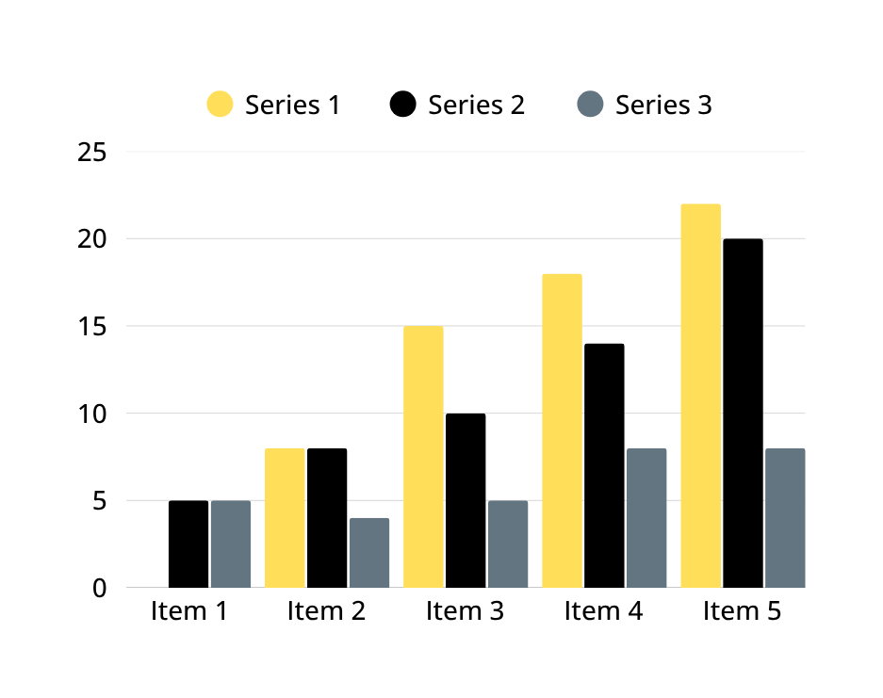
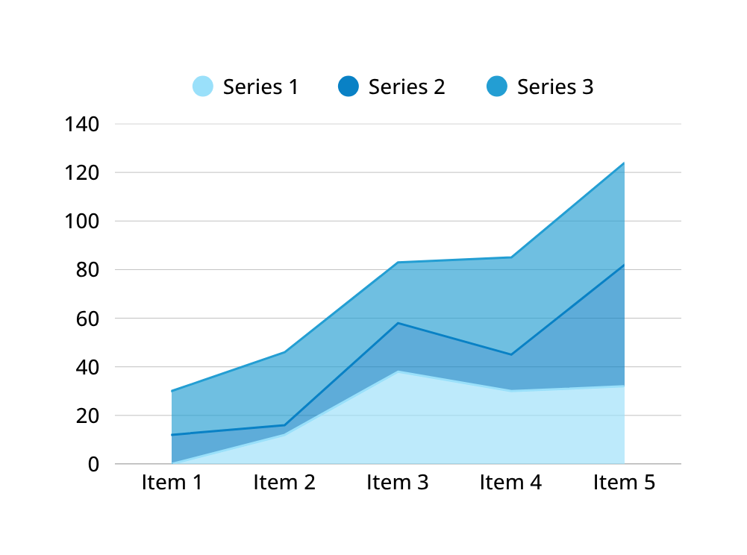
STATISTIC
Thynk Unlimited
Our Customer’s Satisfaction
Repeat Order Rate
An impressive client satisfaction rate underscores our unwavering commitment to delivering exceptional service and exceeding expectations.
Our remarkable client repeat order rate of 123 times are testament to the quality of our products/services and the trust our clients place in our ability.

Slide 10


STAKEHOLDER
As stakeholders in your success, our commitment goes beyond delivering exceptional services; we prioritize understanding and aligning with the unique goals and values of our clients.
 | Internal Stakeholder | External Stakeholder | Priority Stakeholder
Stakeholder Name
Stakeholder Name
Stakeholder Name

Slide 11
OUR TEAM
Our team is a diverse blend of creative minds, strategic thinkers, and industry experts committed to propelling your business to new heights. With a passion for innovation and a collective dedication to excellence, we bring a wealth of experience and fresh perspectives to every project.
Howard Ong
Dani Martinez
Matt Zhang
Thynk Unlimited
Chief Product Officer
Project Manager
Marketing Manager

Slide 12
TESTIMONIAL
Thynk Unlimited
In a world flooded with marketing noise, Thynk Unlimited stands out as a beacon of creativity and effectiveness.
In a world flooded with marketing noise, Thynk Unlimited stands out as a beacon of creativity and effectiveness.
Benjamin Shah
Drew Feig
In a world flooded with marketing noise, Thynk Unlimited stands out as a beacon of creativity and effectiveness.
In a world flooded with marketing noise, Thynk Unlimited stands out as a beacon of creativity and effectiveness.
Reese Miller
Rufus Stewart

Slide 13
GALLERY
Embark on a visual journey through our gallery, where innovation meets creativity, showcasing a tapestry of successful projects and unparalleled expertise that defines Thynk Unlimited's commitment to excellence.
Thynk Unlimited

Slide 14


Thynk Unlimited
THANK YOU
for your attention
December 2023
hello@reallygreatsite.com
www.reallygreatsite.com

Slide 15

